Slide 1
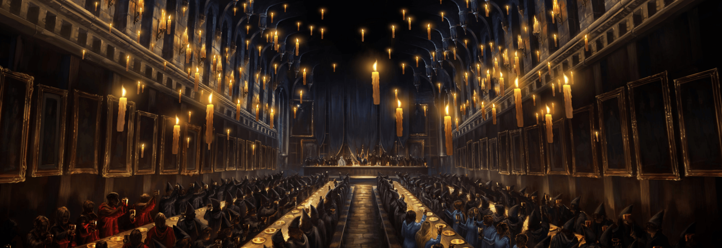
Board Game
Group Project ( Abas and Diana )

Slide 2
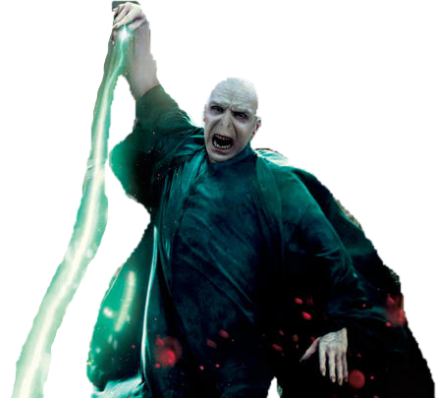
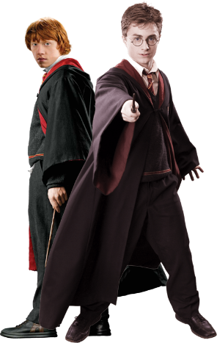
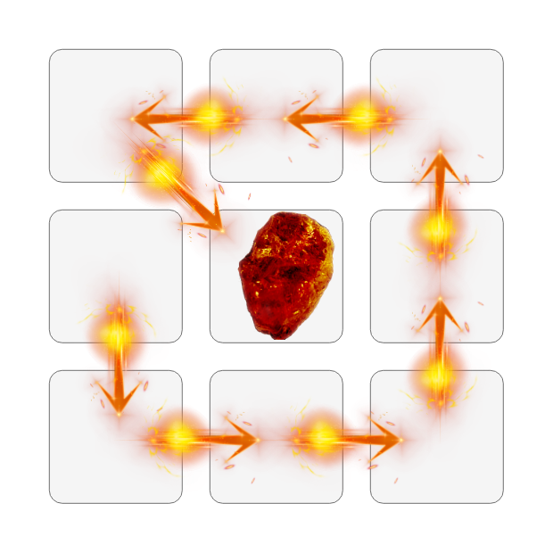
Introduction
Dice: Minimum value 1, Max value 3
Safespot: Starting place is the only safe place where both players can co-exist
Outside of the Safespot either player can kill the other if they land in their position.
When either player kills their opponent:
Opponent goes back to the Safespot
When a player is at position:
6: dice value is 3 that move will be skipped and given to opponent
7: dice value is 2,3 that move will be skipped and given to opponent
FINISH
START

Slide 3
Team description
Abas Abdi
Worked on the game logic and the kill/skip features as well as code output, code snippet, team description, and conclusion.
Diana Percatkina
Worked on the board setup and the player functions as well as the Flow chart, Pseudocode, Introduction, documentation design, and conclusion.

Slide 4
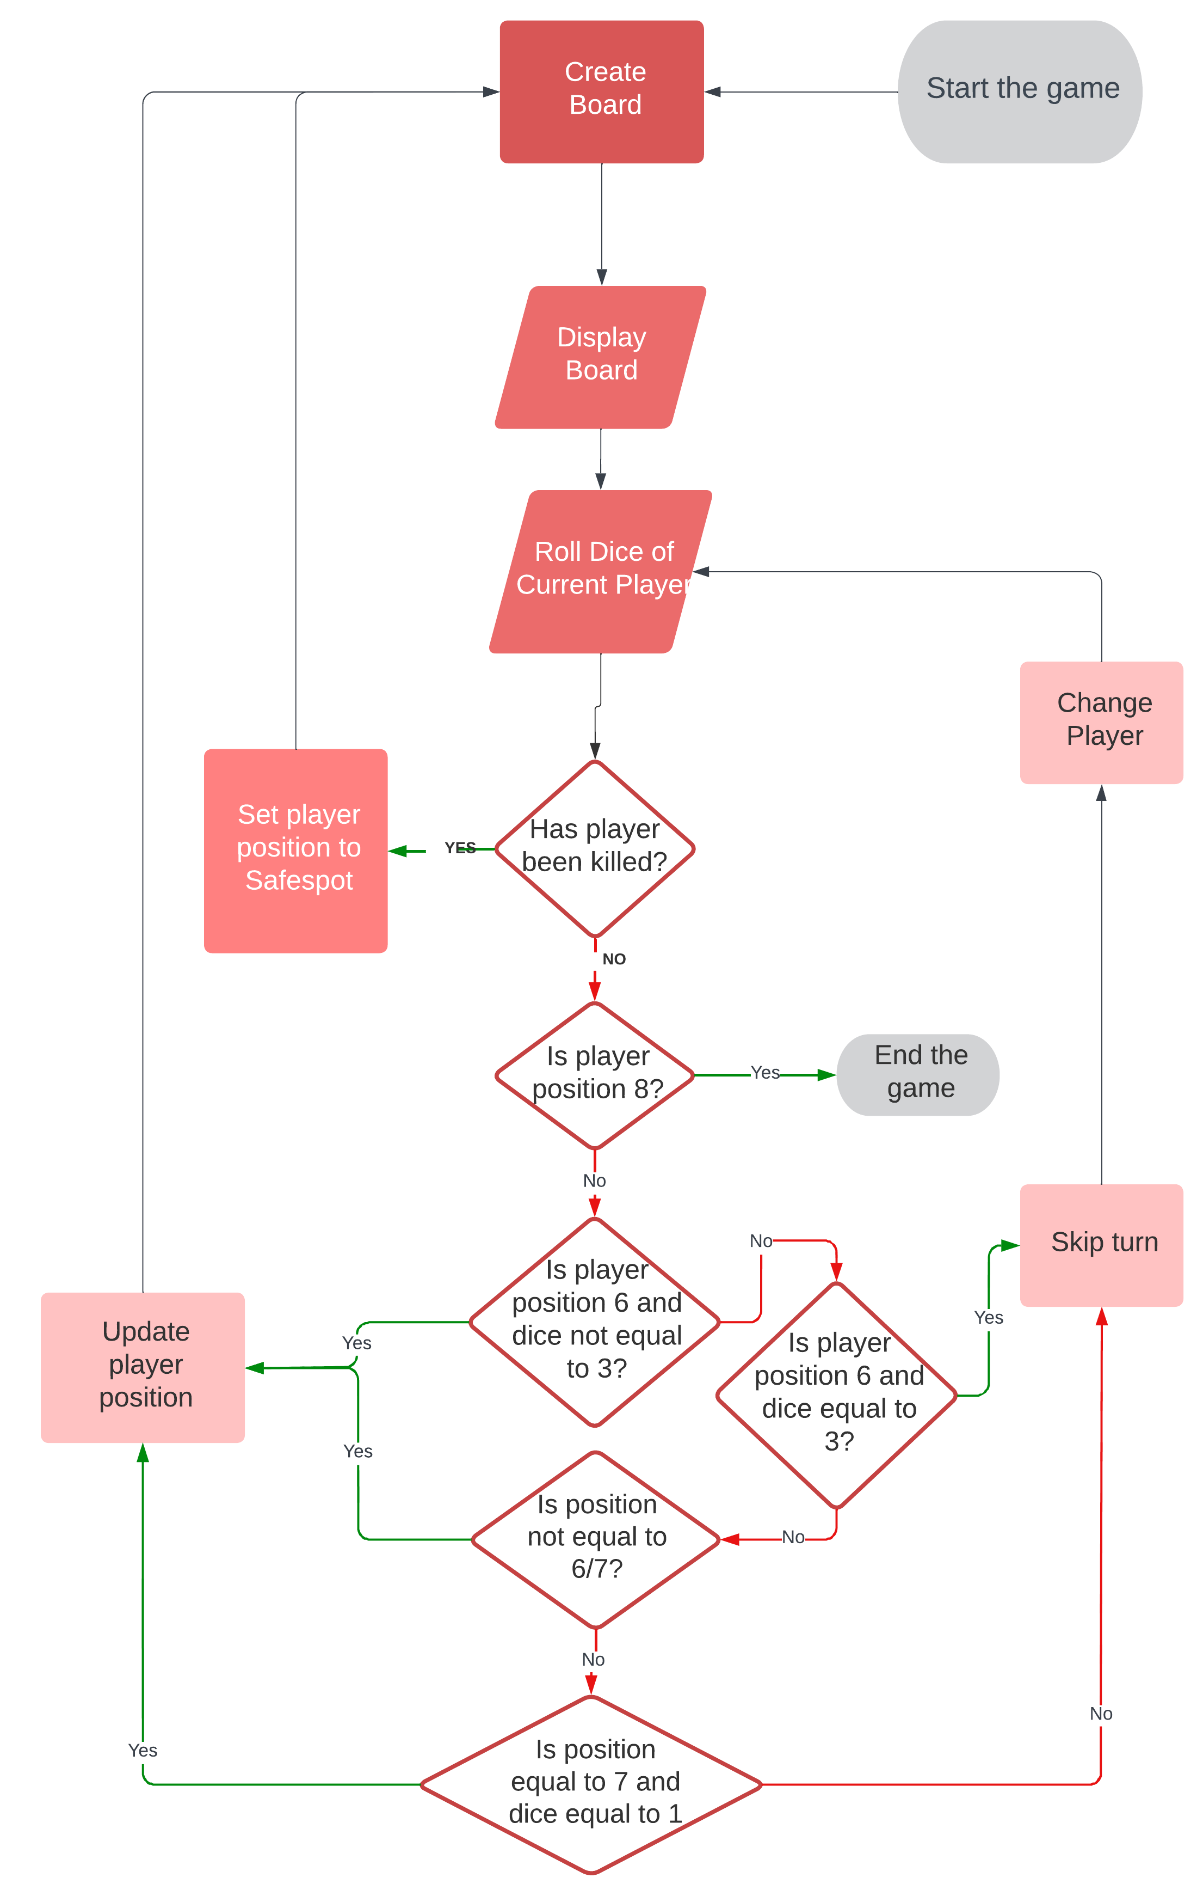
Flowchart

Slide 5
Pseudocode
Generate a board with players on starting position = 0
While players have not reached the finish position = 8:
For both Players , a random dice number is generated from 1 to 3
Player1 goes first by generated number
Update player position by adding the dice value
IF Player 1 or Player 2 position IS NOT equal to 8:
IF position is occupied by other player:
Player who rolled new position kills current Occupant
IF position is free:
Player moves to a new position
Next move going to other Player
IF Player 1 or Player 2 position IS equal to 8:
Finish the GAME
Winner Output

Slide 6
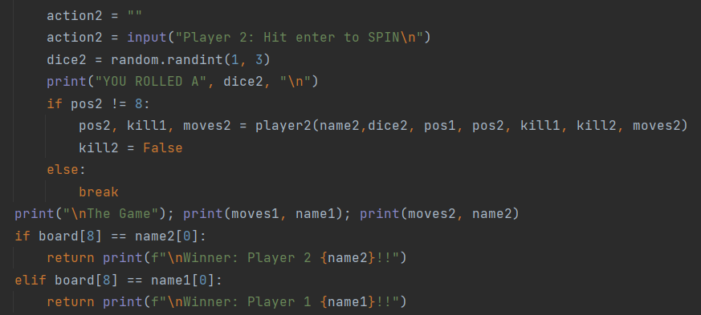
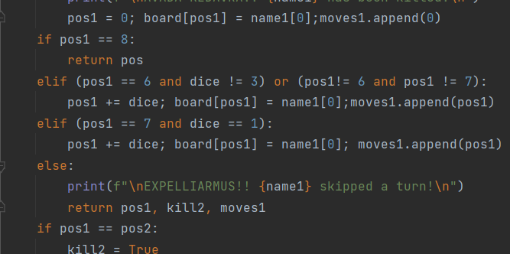
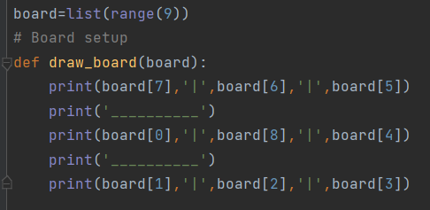
Code snippet
Setting up the board
Defining player functions
Taking user inputs
Enforcing game rules
Recording game moves
Calculating the winner

Slide 7

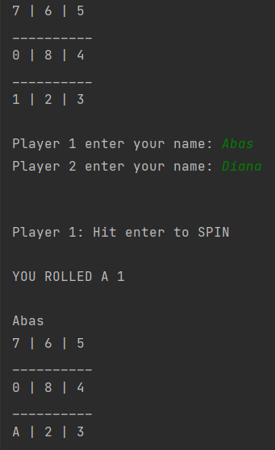
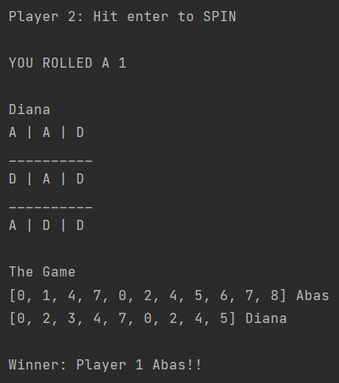
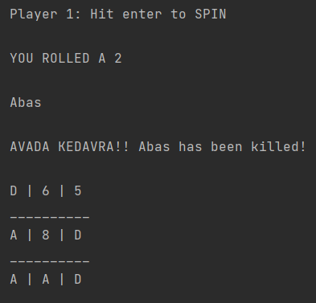
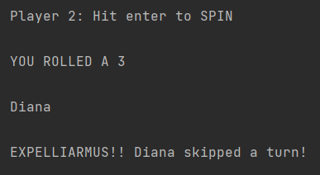
Output

Slide 8
Conclusion: What our team achieved
Board Game Creation with nice interface
Time management
Problem solving
Building the team relationship outside the office

